Slide 1
BGA Desktop Use Condition and Expectation

Slide 2
Legal Disclaimer
You may not use or facilitate the use of this document in connection with any infringement or other legal analysis concerning Intel products described herein. You agree to grant Intel a non-exclusive, royalty-free license to any patent claim thereafter drafted which includes subject matter disclosed herein.
No license (express or implied, by estoppel or otherwise) to any intellectual property rights is granted by this document.
Intel technologies’ features and benefits depend on system configuration and may require enabled hardware, software or service activation. Learn more at Intel.com, or from the OEM or retailer.
No computer system can be absolutely secure. Intel does not assume any liability for lost or stolen data or systems or any damages resulting from such losses.
The products described may contain design defects or errors known as errata which may cause the product to deviate from published specifications. Current characterized errata are available on request.
Intel disclaims all express and implied warranties, including without limitation, the implied warranties of merchantability, fitness for a particular purpose, and non-infringement, as well as any warranty arising from course of performance, course of dealing, or usage in trade.
Intel technologies’ features and benefits depend on system configuration and may require enabled hardware, software or service activation. Learn more at intel.com, or from the OEM or retailer.
All information provided here is subject to change without notice. Contact your Intel representative to obtain the latest Intel product specifications and roadmaps.
Copies of documents which have an order number and are referenced in this document may be obtained by calling 1-800-548-4725 or visit www.intel.com/design/literature.htm.
Intel, and the Intel logo are trademarks of Intel Corporation in the U.S. and/or other countries.
*Other names and brands may be claimed as the property of others.
© 2021 Intel Corporation. All rights reserved.

Slide 3

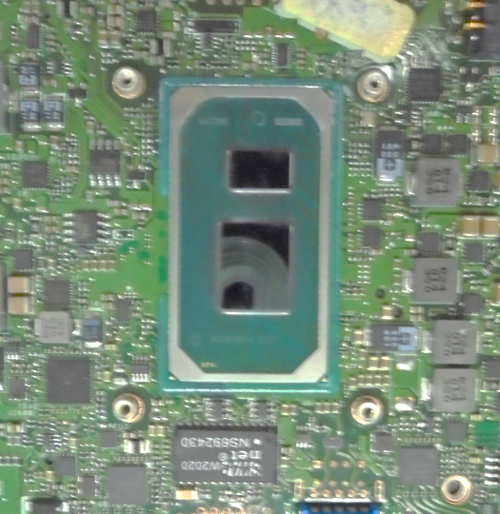
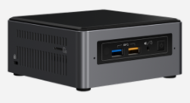
Background
The solder joint reliability (SJR) requirement of desktop product is defined based on use condition. The goal of this survey is to collect feedback from customers to refine SJR requirement of desktop system.
This survey focuses on the desktop products with soldered BGA CPU:
  Mini PC, set top box
  All-In-One PC
  Figure1. Examples of Mini PC, All-In-One PC and BGA CPU on motherboard

Slide 4
Solder Joint Reliability Fundamentals
Solder joint reliability (SJR) is the ability of the solder joints connecting a BGA package to a system board or card to withstand the stresses to which they are exposed during manufacturing, shipping, and End-User operation
  Stresses to the solder joint can come from different sources, including CTE (critical-to-function) induced stress, static mechanical loads, and dynamic mechanical loads
To accommodate for solder joint stresses, BGA packages are designed with NCTF (non-critical-to-function) joints in high stress areas
  These joints can fail without negatively impacting package capability
SJR risk is assessed based on package attributes and mechanical modeling, and if needed, empirical data collection

Slide 5
Solder Joint Reliability Overview
Intel certifies Client BGA products using data collection and/or mechanical modeling based on empirical data collection
The primary reliability stresses that Intel uses for BGA Solder Joint Reliability certification are accelerated temperature cycling and shock tests. These tests envelope many of the stresses BGA packages will go through. Intel does not complete 4-point bend, thermal shock, or sequential temperature cycle and shock testing.
Test | Requirement | Failure Criteria
Temperature Cycle | Based on use condition¹ (desktop) | 1000 ohm resistance spike on CTF chain
Shock | 5 drops at 100 G² (laptop) 5 drops at 125 G² (tablet) 5 drops at 135 G² (desktop) | In situ electrical opens on CTF joints
1 KBQ requirement calculated based on Intel models using Norris-Landzberg.
2 These shock conditions are for a 45 mm x 24 mm package form factor. Different form factors may have different equivalent shock conditions.

Slide 6
BGA Desktop Survey
  The questions focus on desktop products with soldered BGA CPU:
    Mini PC, set top box
    All-In-One PC
  There are six sections:
  What Intel BGA products are used in desktop products?
  Do you perform board level SJR testing - JEDEC standard temperature cycle testing?
  Do you perform system level SJR testing?
  What are the product temperature conditions?
  How many power cycles do you anticipate?
  Do you use board level adhesives?

Slide 7
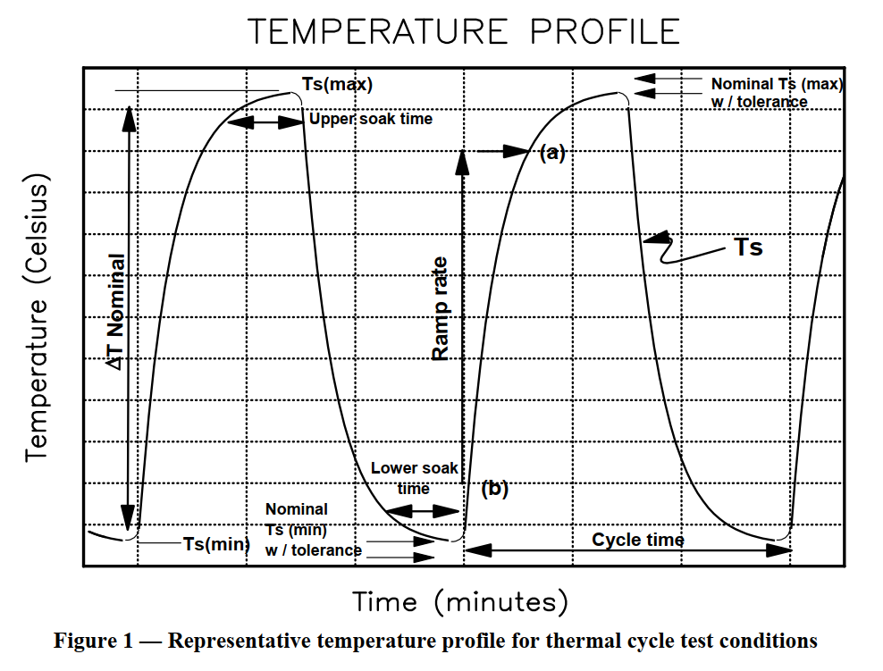
JEDEC Standard Temperature Cycle
Scope: This test is conducted to determine the ability of components and solder interconnects to withstand mechanical stresses induced by alternating high- and low-temperature extremes.
Boards are placed in the temperature cycling chamber and heated or cooled inside the chamber.
Use Temperature Cycle – X (TCX) as an example:
Temperature range: -40 ˚ C to 85 ˚ C
Dwell time: 15 min at -40 ˚ C ; 15 min at 85 ˚ C Cycle time: 1 hour
Reference: JESD22-A104F

Slide 8
Backup

Slide 9
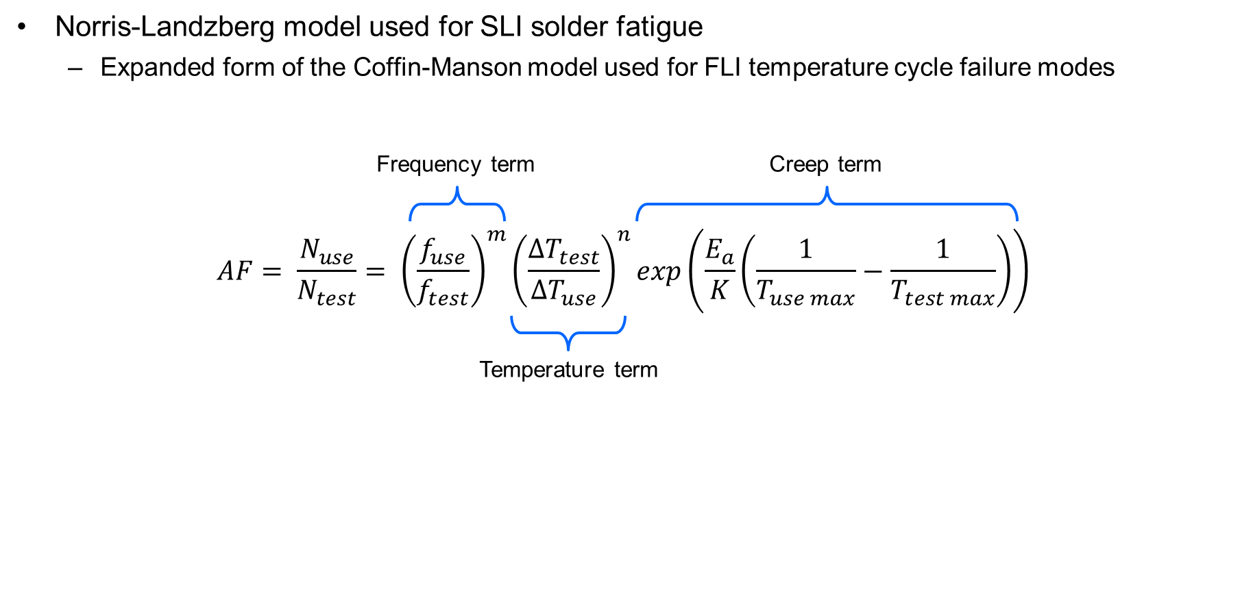
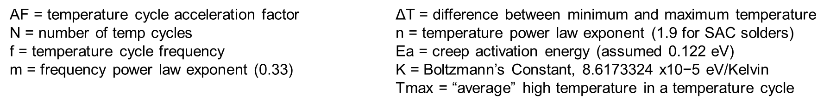
Norris-Landzberg Model

Slide 10
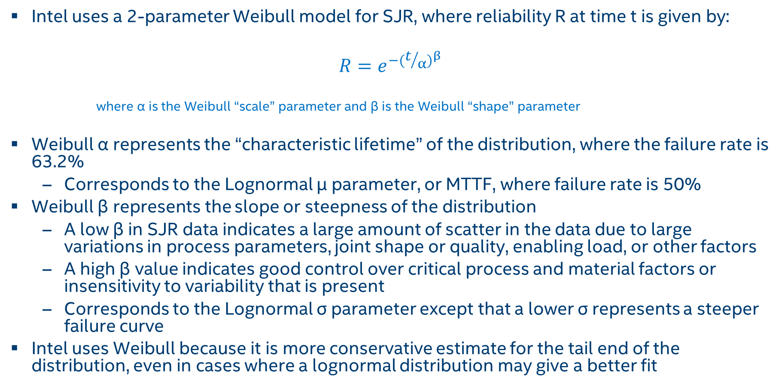
Weibull Distribution
  Intel uses a 2-parameter Weibull model for SJR, where reliability R at time t is given by:
$$R=e^{{−(t/α)}^{β}}$$
where α is the Weibull “scale” parameter and β is the Weibull “shape” parameter
  Weibull α represents the “characteristic lifetime” of the distribution, where the failure rate is 63.2%
    Corresponds to the Lognormal μ parameter, or MTTF, where failure rate is 50%
  Weibull β represents the slope or steepness of the distribution
    A low β in SJR data indicates a large amount of scatter in the data due to large variations in process parameters, joint shape or quality, enabling load, or other factors
    A high β value indicates good control over critical process and material factors or insensitivity to variability that is present
    Corresponds to the Lognormal σ parameter except that a lower σ represents a steeper failure curve
  Intel uses Weibull because it is more conservative estimate for the tail end of the distribution, even in cases where a lognormal distribution may give a better fit

Slide 11
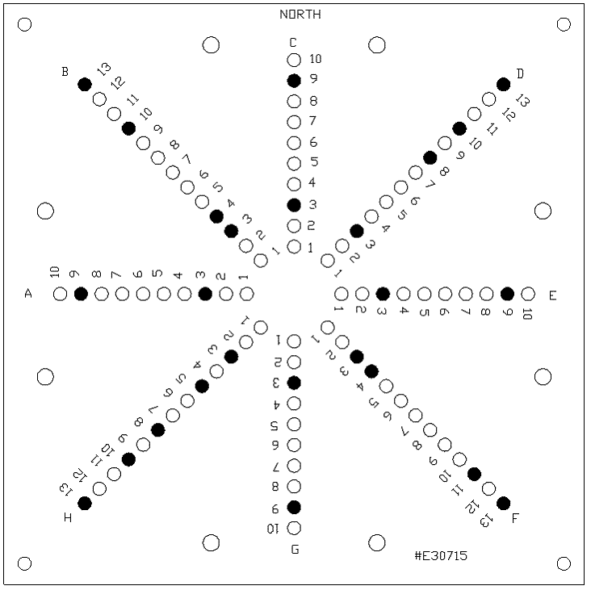
Client Shock Certification Test Setup
SG1
SG3
  Diagonal bend mode, -z direction, 2 ms half-sine pulse
  In-situ electrical monitoring of the daisy chain
  Intel Shock Test Board (STB)
  No Adhesives
Shock requirements are based on translation from 6-axis system-level drop data
  Client Req’ts: 5 drops @ 100G (Laptop)
  5 drops @ 125G (Tablet)
  5 drops @ 135G (Desktop)
  Success criteria: No in-situ electrical opens on any CTF joint for above laptop or tablet req’ts
  To set G level, dropped boards from industry standard heights in all 6 orientations with strain gauges. Ran models based on board strain in different orientations to come up with equivalent -z only shock req.
    Drop parameters: 3 drops in each orientation from 0.6 m + 1 drop in worst case orientation from 1 m
Board Masses
Supports

Slide 12
Shock Strain Gauge Placement
Shock Strain Gage Placement
  Strain gauges are placed following IPC 9703
  Strain gages are located on the secondary side of the board at the package corners.
  The location of the strain gage is at the intersection of second row and second column of the BGA array (regardless of corner most ball depopulation)

Slide 13
Client Temperature Cycle (TC) Test
TC testing was performed per Intel test condition:
Temp. Cycle-T (TCT) range: -40 ˚ C to 100 ˚ C
  15min dwell; 1 hour cycle
  In-situ electrical monitoring of the daisy chain
  Intel Enabling Test Board (ETB) design
  No adhesives
TCT requirements based on standards from client market
  Number of TCT cycles for desktop - use condition base
  Failure criteria - 1000 ohm resistance increase
  Test-to-Fail (TTF) until 60% of the population fails
Other stresses are used as needed based on technical need and product specific use condition

Slide 14
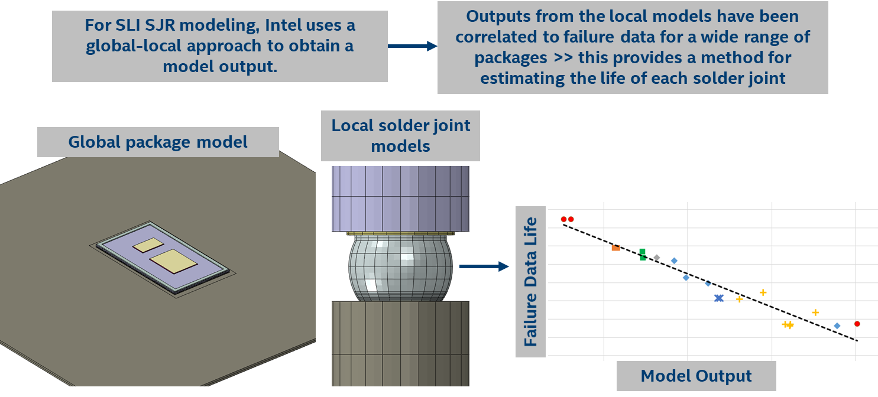
Intel Proprietary SJR Modeling Methodology Example

